Slide 1
VALUE CAPTURE INDUSTRY SYSTEM

Slide 2
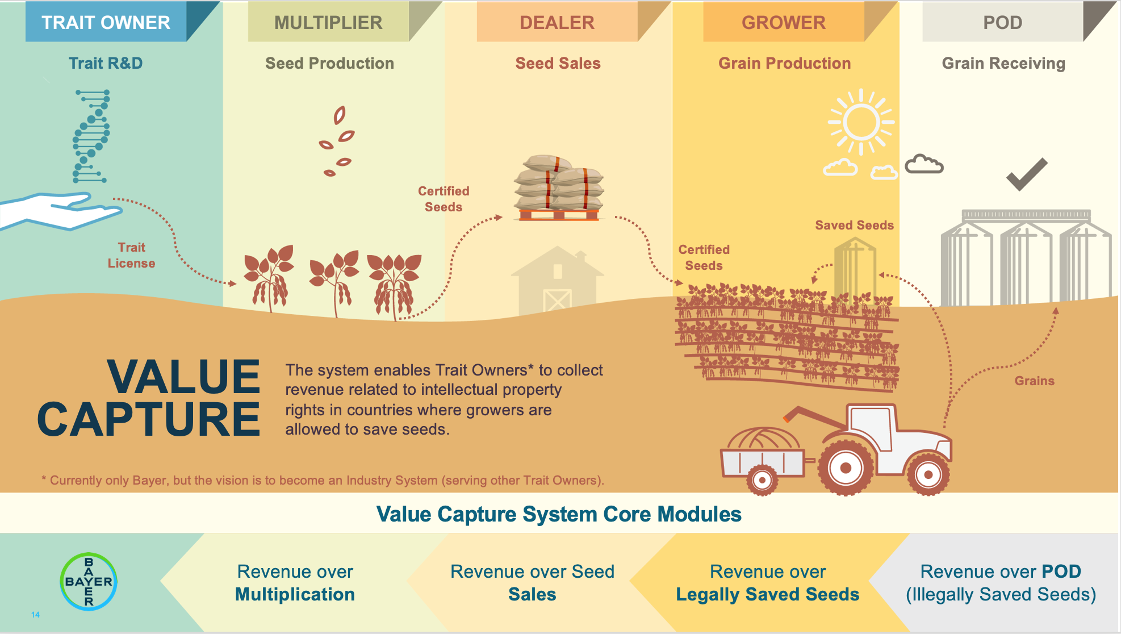
VALUE CAPTURE - INTRODUCTION

Slide 3
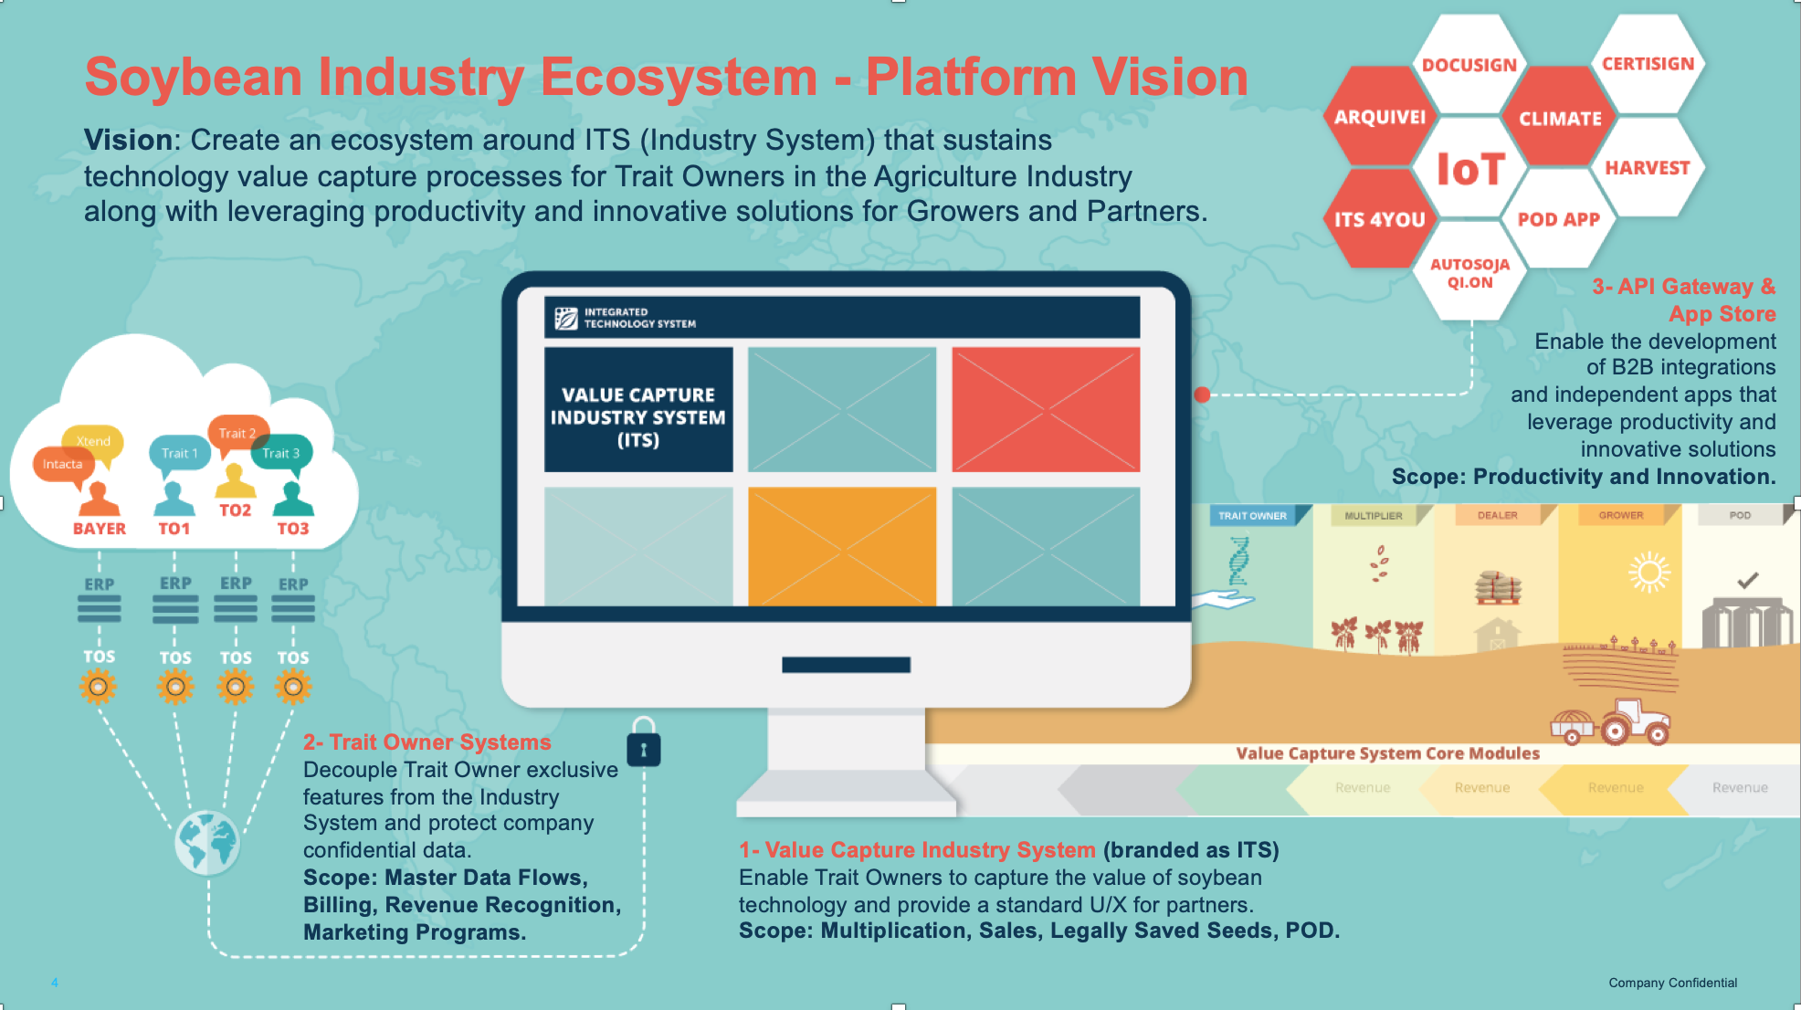
INDUSTRY SYSTEM - PLATFORM VISION

Slide 4
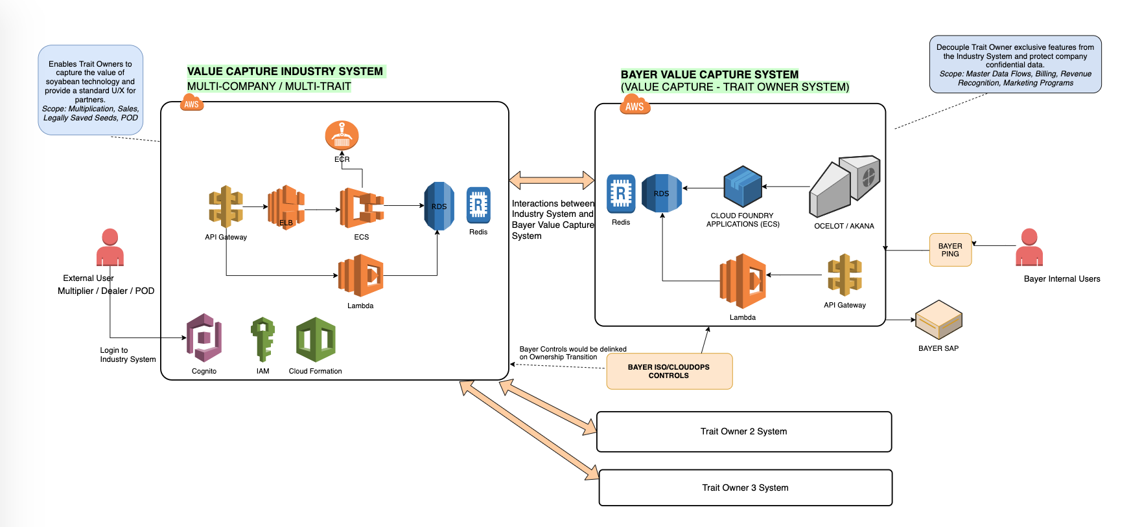
VC - INDUSTRY SYSTEM
HIGH LEVEL ARCHITECTURE

Slide 5
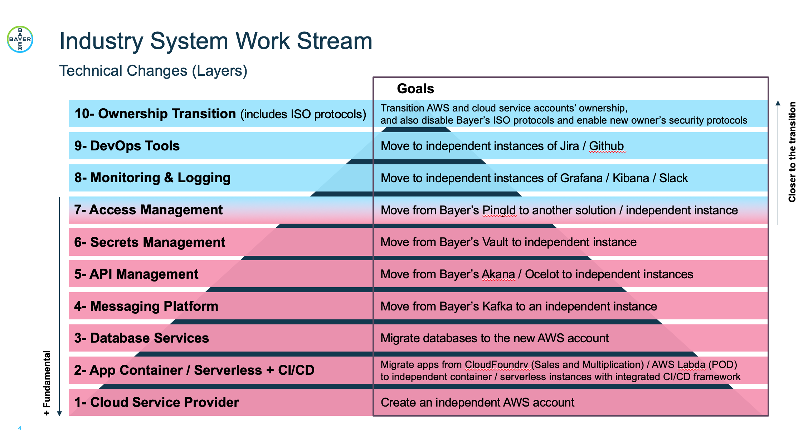
Industry System Technical Foundations & Migration

Slide 6
INDUSTRY SYSTEM INITIATIVE
Mystery Machine Team was formed within Value Capture
To focus on the effort of setting up Industry System Cloud Infrastructure setup in new AWS accounts independent of Bayer infrastructure.
Provide migration plan and migrate services to Industry System AWS accounts.
Implement necessary ISO / CloudOps controls and monitoring in Industry System AWS accounts to be secured and SOX complaint.
Slalom: Since Value Capture development team was lacking Cloud Operations experience; 3 Slalom engineers are working as part of Mystery Machine team on Industry System Cloud Initiative.

